Slide 1
Microservices and DevOps
DevOps and Container Technology
Docker Swarm
Henrik Bærbak Christensen

Slide 2
Docker Swarm
” A swarm consists of multiple Docker hosts which run in swarm mode and act as managers (to manage membership and delegation) and workers (which run swarm services).”
Swarm manager:
You can execute docker commands
Worker:
Slaves that can only accept services from the manager
Node: Physical or virtual machine
In production, a physical machine makes most sense, but in the cloud, well…

Slide 3
Service and Task
Service = the definition of a task to execute
That is, a running container
The ‘services:’ section of the docker-compose file
Replicated service
A service can be replicated, that is you define how many instances of it to run
Task
‘container + commands to run it’
assigned to a node; will never leave it

Slide 4
Cluster Creation
On my ESXi hypervisor, I created
Headless Ubuntu 18.04 LTS machines
Malkia00 and three Nyuki’es (queen and bees ☺)
‘docker swarm init’ Creates a join token
3 x ‘docker swarm join’ Using the join token

Slide 5
Small Cluster Creation
In our context, Swarm is very approachable as a swarm may consist of a single node.
Just ‘swarm init’ in Mxx, and you can test run all your work, just as if it was on a multi-node swarm
(Of course, RAM and CPU are limiting factors…)

Slide 6
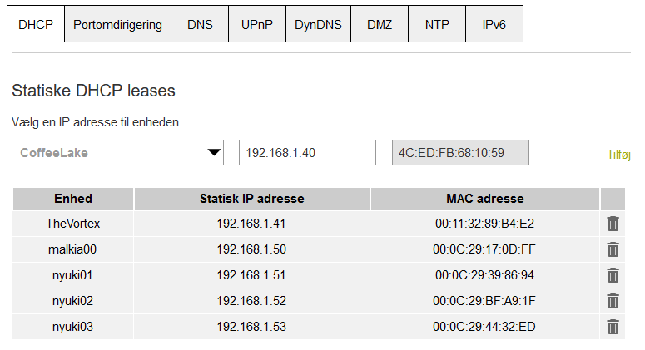
SideNote
Swarm nodes talk through static IP addresses
I.e. they need these to be fixed
On my home router in my Corona Bubble lab I found that I could assign static DHCP leases to swarm nodes

Slide 7
Stack
You can manipulate services directly using docker engine commands
That is – manual interaction ☹
Infrastructure-as-code
Automate through scripting
Stack: Group of interrelated services that share dependencies, and are orchestrated and scaled together.
Compose-file: IaC for defining how containers behave in production. Writting in a specific YAML format.
Or is it a ‘stack file’? Shooting a moving target ☹

Slide 8
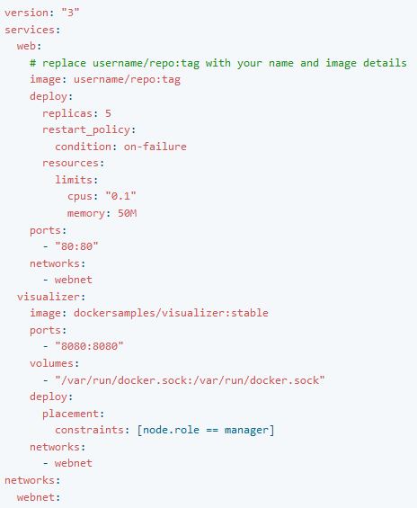
Anatomy of Compose-file
A typical Compose-file
YAML file
Hierarchy by indentation
(use spaces!!!)
(be aware of whitespace)
State
Services to deploy
Networks to create
(Volumes to create)
…

Slide 9
Anatomy of Compose-file
Service definition
Docker image that holds task
Only docker hub images (or in local image cache)
Properties
Ports to expose
Network to use
(Volume to use)
Etc.

Slide 10
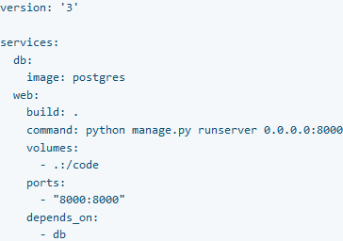
Anatomy of Compose-file
Instructing the service/task
Command:
Overrules CMD in image
Depends_on:
States service dependencies and order of service starts
But swarm does not respect ‘is-up’ by services even if there is a depends_on
If the ‘db’ is slow to start, the client service may try to connect before it will accept connections ☹
Only ‘image:’ tag possible in stacks

Slide 11
Orchestration
Services need to communicate with each other...
Each container on the network is assigned the ‘service name’ as hostname
A swarm has its own DNS
There will be a node named ‘db’ and one named ‘web’ on this network!
So, you have to configure your ‘manage.py’ to connect to ‘db:5432’ (postgres port).

Slide 12
Anatomy of Compose-file
Format 3.x of compose-file allows deployment to be specified!
Here:
5 instances, limit use of CPU and mem
(max 10% cpu/50MB),
and set restart policy

Slide 13
Five Instances???
The default network of swarm is a ingress routing mesh:

Slide 14
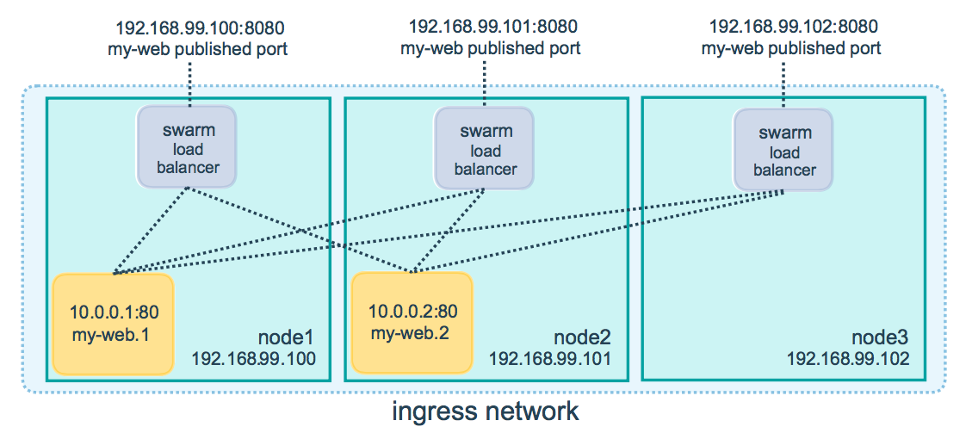
“Load Balancing”
Ingress routing mesh: Each node in swarm accepts connections on published ports for any service in the swarm

Slide 15
Example
My Telemedical application is on my malkia swarm:
But can upload measurements on any node in swarm

Slide 16
SideBar
We will talk more about horizontal scaling and load balancing later…

Slide 17
Routing
”The swarm makes the service accessible at the target port on every swarm node. If an external host connects to that port on any swarm node, the routing mesh routes it to a task. The external host does not need to know the IP addresses or internally-used ports of the service tasks to interact with the service. When a user or process connects to a service, any worker node running a service task may respond.”
Note: It states ‘swarm load balancer’ on the previous figure, but – it is not round-robin ☺. It “routes incoming requests to published ports on available nodes.”
Which may be hitting the same node again and again…
If it is not working too hard…

Slide 18
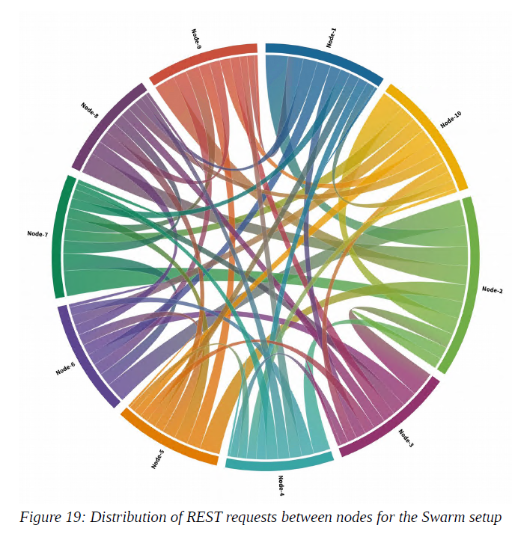
Peer Bech’s Thesis
Peer’s Master Thesis (2020)
10 AWS nodes in swarm, having 40 REST containers, and hitting the cluster with JMeter generated traffic…
Looks like the swarm does a pretty good job at distributing load…

Slide 19
Stack Manipulation
Docker commands for manipulating a stack:
‘docker stack deploy –c (composefile) (stackname)’
‘docker stack ls’ List running stacks
‘docker stack ps (n) List tasks in stack ‘n’
‘docker stack services (n)’ List services in ‘n’
‘docker stack rm (n)’ Remove stack ‘n’
Only works on a manager node
Tech note: deploy with ‘--with-registry-auth’ if your image is only available in a private repository...

Slide 20
Service Manipulation
‘stack deploy’ starts services in the swarm, so
‘docker service ls’ Shows running services
‘docker service ps (name)’ Shows ‘ps’ status of service
‘docker service logs (name)’ Shows logs for all replicas of given name
(provide the –f to ‘logs’ to follow/tail the log output)

Slide 21
Example
I made a full SkyCave system (Stack ‘dilab’)
Subscription service with associated MongoDB, 2x SkyCave daemons with shared Memcached db and a Docker visualizer

Slide 22
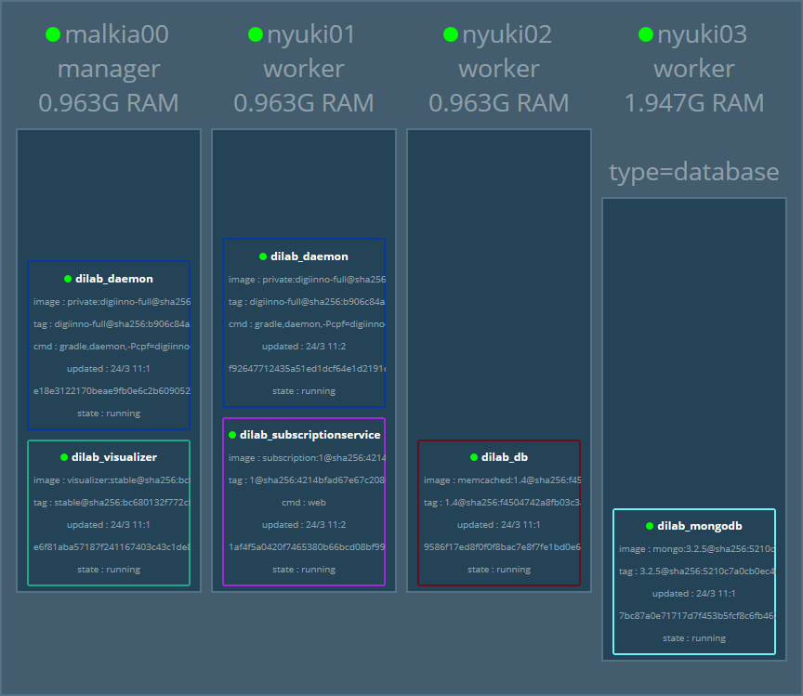
Deployment
One node has
More RAM
More Disk
‘type=database’
I can state that the MongoDB must be deployed on such a node.

Slide 23
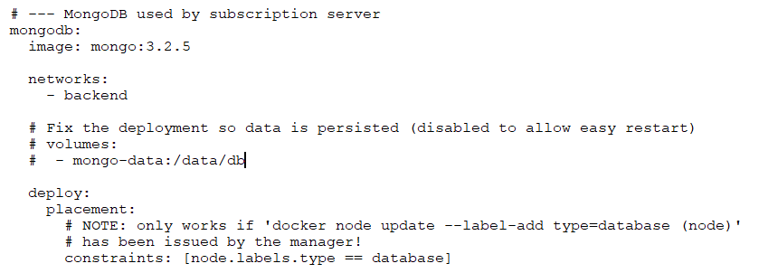
Constraints
Wire the DB to the right VM

Slide 24
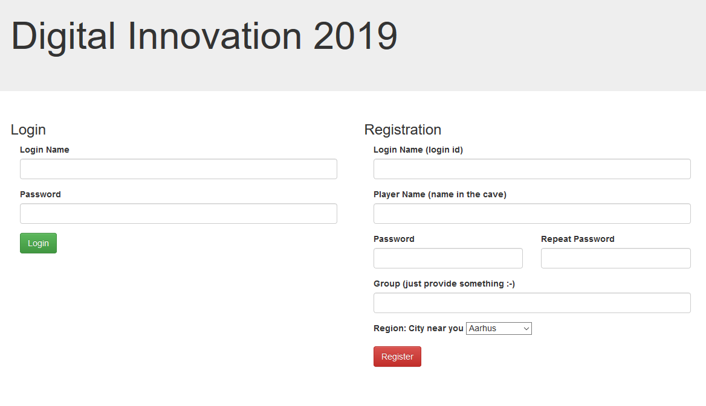
And Visually

Slide 25
Updating the Stack
Two central operations
I need to adjust the stack’s configuration
Edit the compose/stack file
Issue the ‘docker stack deploy’ again
Easy for stateless services
For instance change the replication factor of ‘daemon’
Not so easy for statefull services
Do not move a db service away from its volume ☺
Solution: Use architecture for that – redundancy!
I need to do maintenance of node X
Docker node drain X

Slide 26
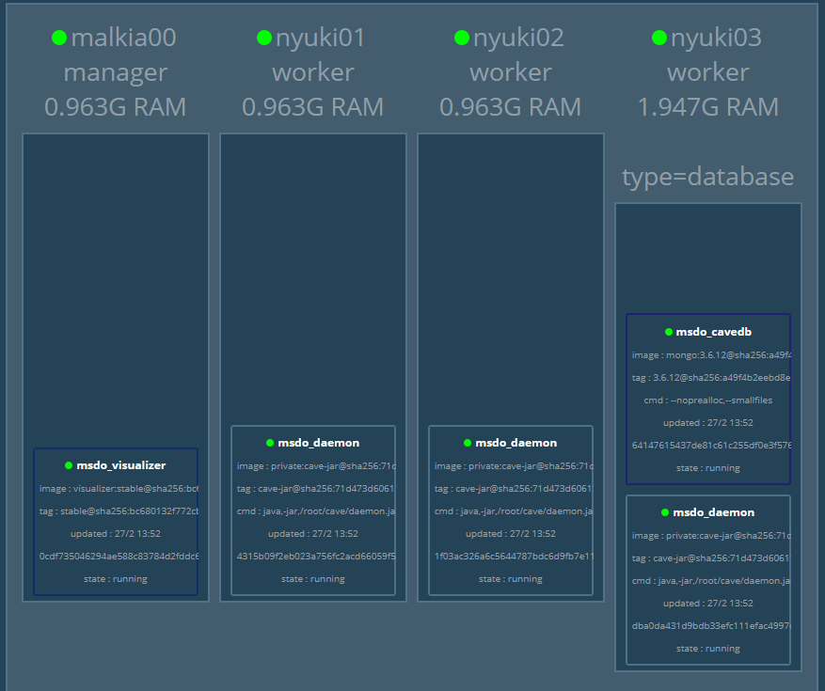
Drain
Need to do stuff on nyuki02

Slide 27
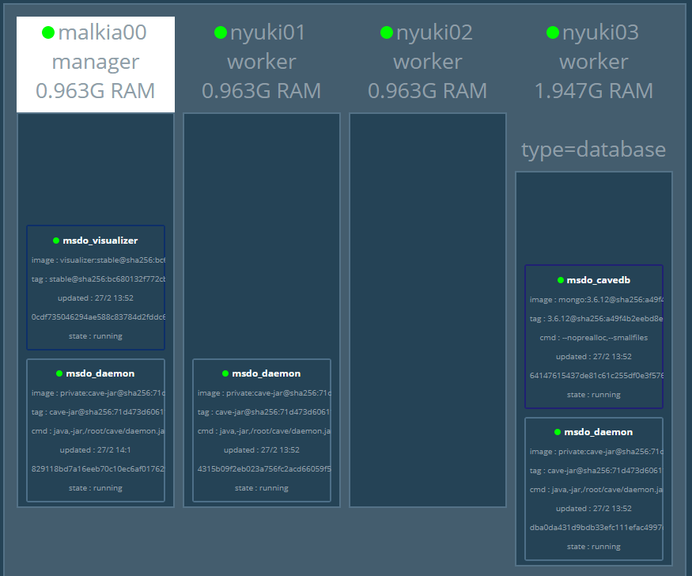
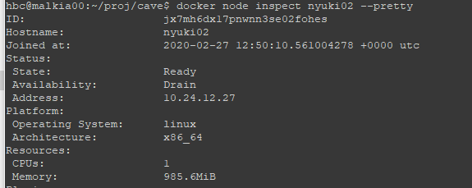
Drain
Service now deployed on malkia00

Slide 28
Back to work

Slide 29
Updating the Stack
Old services actually hang around
To allow rollback
(But I am not aware of efficient prune command…)

Slide 30
Persistence
An ordinary docker container can mount specific folders on the host’s file system
Ex:
Mongo stores data in folder /data/db, so
-v ~/my-mongo-folder:/data/db
Will ensure that this folder is mounted as ~/my-mongo-folder on the host machine
But – swarm services may be redeployed?!?

Slide 31
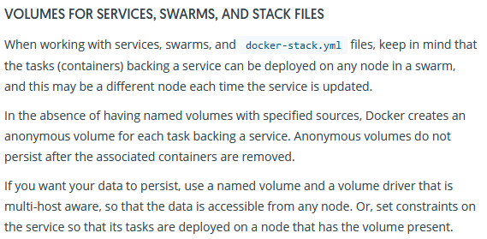
Persistence
Solution: Use ‘named volumes’

Slide 32
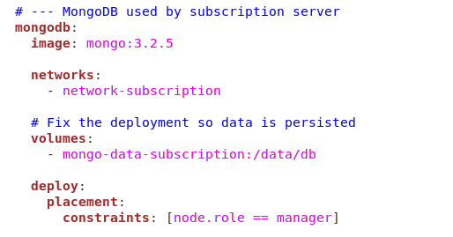
Example:
From the compose file of the ‘cavereg.baerbak.com’ subscription service

Slide 33
Secrets
Secret = Blob of data
Passwords, keystore files, certificates, you name it
Ex: ‘docker secret create baerbak.jks /home/secret/baerbak.jks’
Once created, is distributed using TLS to all nodes
i.e. all nodes in swarm have proper access
A service must be given access to a secret
‘secrets:’ section in compose file

Slide 34
Compose?
It is swarm and stacks and services
Why is it then called a ‘compose file’
Docker compose was a precursor to swarm
And still maintained… You need to install ‘docker-compose’
Main difference to swarm
Runs ONLY on a single node (all services deployed locally)
‘image: ..’ entry could be replace by ‘build: …’
So compose-files could refer to local Dockerfiles and include the build step…

Slide 35
Summary
Infrastructure-as-code:
Finally, full production architecture is codified!
The terminology layering
Service
A single container running in ‘docker-engine’
Docker-compose
Sets of containers deployed on single docker-engine
Swarm
A set of docker-engines clustered in a network
Stack
A set of services deployed on a swarm

Slide 36
Appendix
Setting up the Swarm

Slide 37
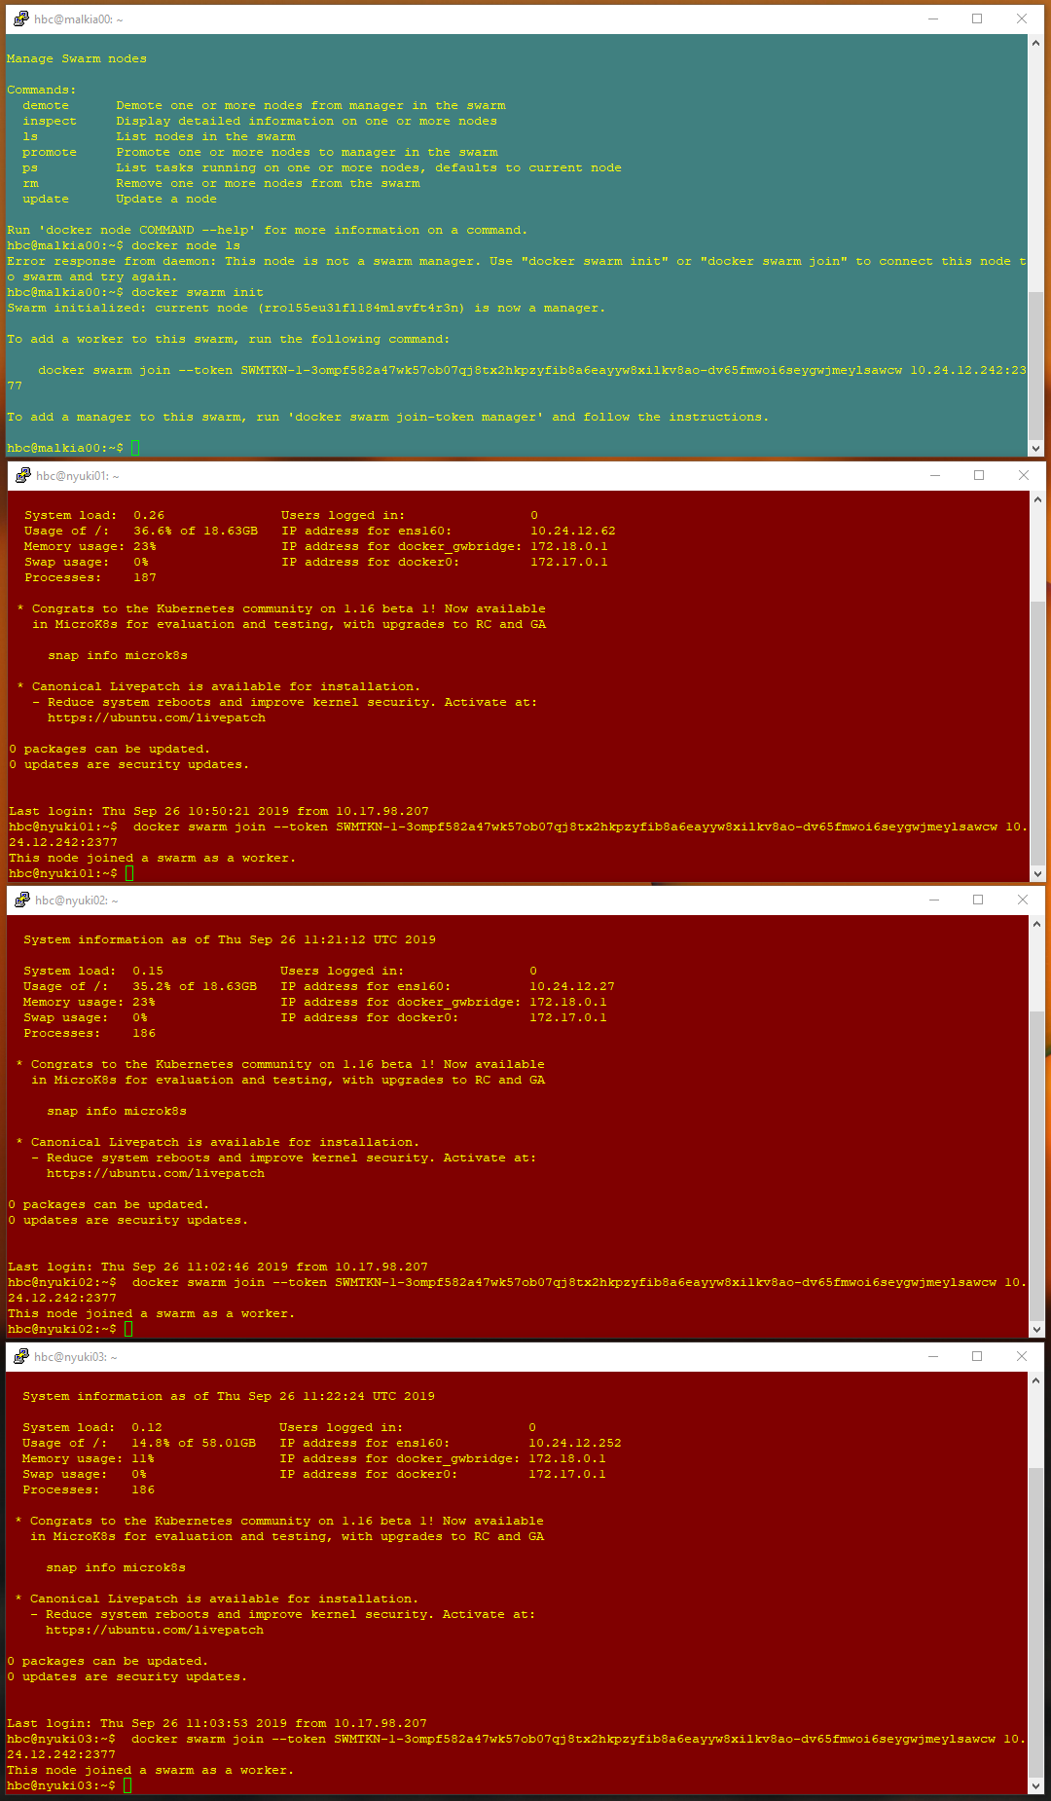
Init

Slide 38
Status
Overview
Setting type

Slide 39
TestRun
Run subscription service with MongoDB on ‘database’ node
Notes:
Swarm file is in ‘msdo-operations’ git project.

